Slide 1
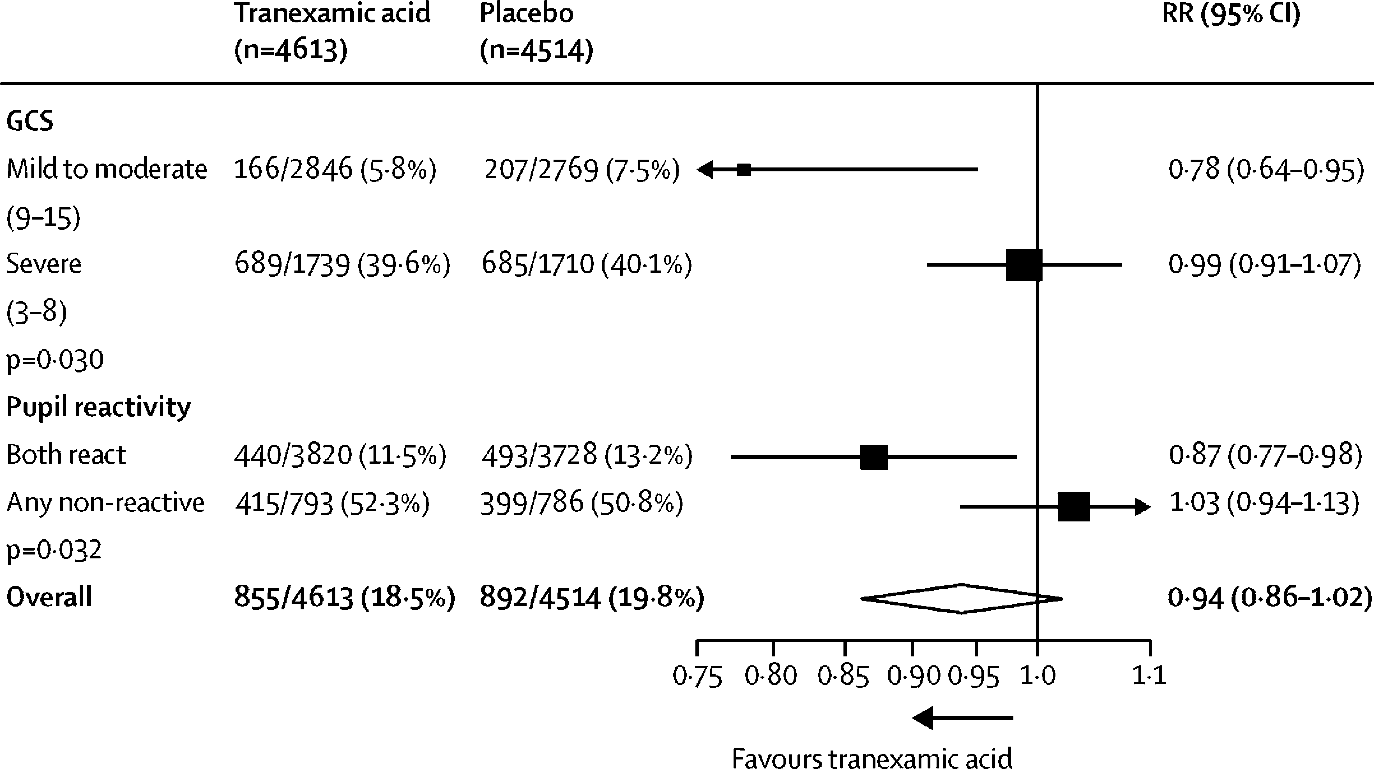
Figure 3
The Lancet 2019 394, 1713-1723DOI: (10.1016/S0140-6736(19)32233-0)
Notes:
Effect of tranexamic acid on head injury-related death stratified by baseline severity in patients randomised within 3 h of injury
RR=risk ratio. GCS=Glasgow Coma Scale.

