Slide 1
ICAT Figures for EudraCT Results upload
February 2021

Slide 2
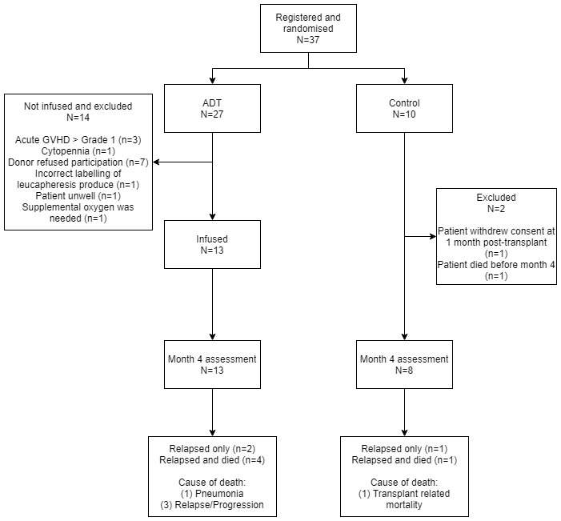
Figure 1: Consort diagram of ICAT recruitment summary

Slide 3
A
B
Figure 2.
The Median CD3 T- cell recovery between the ADT and Control cohorts at 4 months was not significant (p=0.18). (A) Circulating CD3 for all 21 patients post-HSCT. (B) Circulating CD3 post at 4 months. (C) Median circulating CD3 for both control and ADT group. Wilcoxon 2-sided p value at all time points is >0.05
(D) Proportion of patients achieving normal CD3 counts at different timepoints after HSCT.
C
D
Notes:
T cell reconstitution

Slide 4
Table 2: Incidence of acute and chronic GVHD was comparable between cohorts (p>0.99).
Grade of GVHD Reported |  | ADT (n=13) | CONTROL (n=8)
Acute GVHD | Grade 1 | 4 (31%) | 2 (25%)
 | Grade 2 | 4 (31%) | 2 (25%)
 | Grade 3-4 | 3 (23%) | 2 (25%)
Chronic GVHD | Mild | 1 (8%) | 3 (38%)
 | Moderate | 1 (8%) | 0 (0%)
 | Severe | 1 (8%) | 0 (0%)

