Slide 1
Near-infrared fluorescence imaging improve the nodal yield in neck dissection in oral cavity cancer – a randomized study
Abstract
Anders Christensen^{1,2}, Karina Juhl² Katalin Kiss³, Giedrius Lelkaitis³, Birgitte Wittenborg Charabi¹, Jann Mortensen², Andreas Kjær², Christian von Buchwald¹
¹Department of Otolaryngology, Head & Neck Surgery and Audiology, Rigshospitalet, University of Copenhagen, Denmark
²Department of Clinical Physiology, Nuclear Medicine & PET and Cluster for Molecular Imaging, Rigshospitalet, University of Copenhagen, Denmark
³Department of Pathology, Rigshospitalet, University of Copenhagen, Denmark
Objectives: Nodal yield in neck dissection (ND) has been identified as a prognostic factor in oral cavity cancer. Also as a measurement for surgical quality, the nodal yield has become increasingly important. Optical imaging based on optical agents is an emerging imaging modality which allows for intraoperative real-time guidance. The purpose of this study was to investigate the impact of additional use of optical imaging on nodal yield in therapeutic ND in oral cancer.
Methods: Consecutive patients with oral squamous cell carcinoma (OSCC) with clinical neck metastasis planned for primary tumor resection were randomized to conventional neck dissection or near-infrared fluorescence (NIRF)-guided neck dissection, respectively. In the intervention group, patients were given a peritumoral injection with ICG-Nanocoll prior to surgery. Intraoperatively, an optical hand-held camera system was used for lymph node identification. Also, NIRF imaging of the neck specimen was performed on the back table in the OR and optical signals were pinned with needle markings to guide the macroscopic examination. The endpoint of the study was nodal yield pr. neck side in level Ib-III.
Results: 31 patients were included with 17 neck sides in the control group and 17 neck sides in the intervention group for evaluation. During NIRF-guided ND, individual lymph nodes could be identified by a bright fluorescent signal and individual tumor-related drainage patterns could be observed in the neck. The nodal yield in the intervention group was significantly higher compared to the control group (p = 0.032) with a mean of 24 lymph nodes (CI95% (4-20), range: 12-33) in levels Ib-III compared to 19 lymph nodes (CI95% 5-15, range: 10-36) in the control group, respectively. All lymph nodes with tumor deposits were also identified by NIRF imaging. No adverse reactions were observed.
Conclusion: NIRF-guided ND significantly improved the nodal yield compared to the control group. Intraoperative real-time optical imaging enabled direct visualization of tumor-related drainage patterns within the neck lymphatics. Further studies are needed to investigate the possible impact of optical-guided ND recurrence-rate and survival outcome.

Slide 2
Statistical comments
The study size was based on a power calculation with a minimum relevant detectable difference of 2 lymph nodes pr. neck side dissected, a power (1-Beta) of 0.8 and Alpha of 0.05. The needed sample size was 14 neck sides, and we decided to include 17 neck sides in each group. To compare the two groups, control group and intervention group respectively, a Students T-test was performed (see results).
Randomization was performed in blocks of 4 patients by making a randomization list using an online random number generator. The list was stored by a person in the department not involved in the clinical study, and for randomization the person was contacted to provide the randomization for each included patient in the study.
Study monitoring and safety
The study was approved by the Danish Ethical Committee and monitored according to GCP standards by the GCP Unit of the Capital Region of Denmark. Informed signed consent was obtained for all patients included in the study.
Annual safety reports were documented and reported to The Danish Medicines Agency.
No adverse reactions in the intervention group were observed in this study.

Slide 3
Demographics and comparative statistics
Variable | Control group N = 15 | NIRF group N = 16 | p value
Age*** (mean) | 63 | 64 | 0.64
Sex* Male Female | 9 6 | 13 3 | 0.25
Tobacco** Pack years (mean) | 36,9 | 34.2 | 0.65
Alcohol* Current Former Never | 7 1 7 | 3 4 9 | 0.16
BMI**** (mean) | 21.9 | 24.8 | 0.06
cTNM stage** Stage 3 Stage 4 | 9 6 | 11 5 | 0.61
cT stage* T1 T2 T3 T4 | 2 7 5 2 | 4 5 3 4 | 0.61
cN stage* N1 N2a N2b N2c | 10 0 4 1 | 12 0 2 2 | 0.62
pN stage* N1 N2a N2b N2c | 7 0 6 2 | 6 0 8 2 | 0.88
N-site up-staging** Yes No | 5 10 | 6 10 | 0.81
N site procedure time*** (mean) | 116 min | 90 min | 0.06
*Fisher´s exact test, **Chi Square test, ***Student T-test, ****Wilcoxon test (Rank Sums)

Slide 4
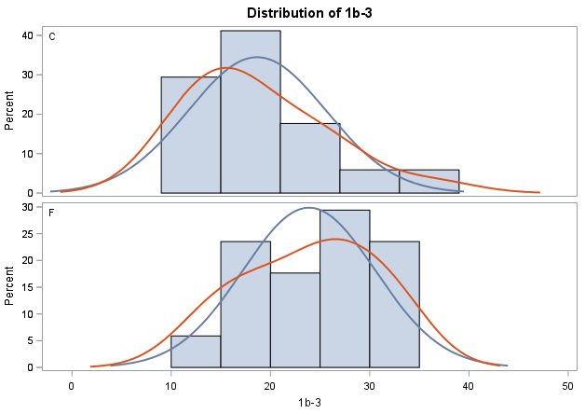
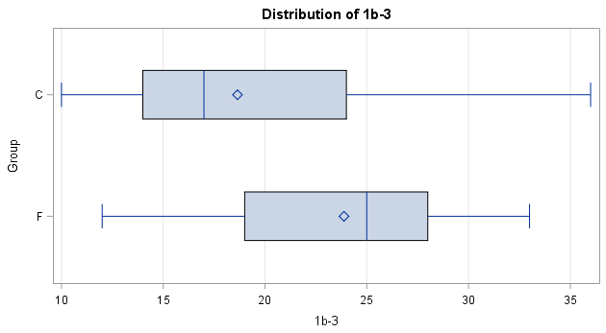
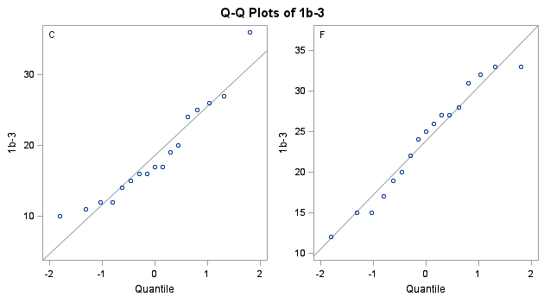
Two-sidet Student T-test comparing Nodal yield level Ib-III from neck dissection in the control group © and the NIRF group (F)

